Slide 1
ONLINE LEARNING PLATFORM
TEAM NUMBER:
TEAM MEMBERS:
HARRINI SHREE K R (211521243065)
HARSHITHA R (211521243066)
HARINI S(211521243062)
JANANI M R(211521243071)

Slide 2
TABLE OF CONTENTS
ABSTRACT
INTRODUCTION
PROPOSED SYSTEM
IMPLEMENTATION: MERN STACK
FRONTED
BACKEND
INTERGRATION
BLOCK DIAGRAM
MODEL SCREENSHOT
CONCLUSION

Slide 3
ABSTRACT
In this project, the MERN stack—MongoDB, Express, React, and Node js is used to create an online learning platform. By providing classes, tests, and real-time communication, the platform seeks to give educators and students a smooth, intuitive experience. MongoDB ensures effective data handling by acting as the database for user data, course materials, and progress monitoring. The backend is powered by Express and Node.js, which provide scalable and safe communication between the frontend and database. Because React is used for the user interface, users are guaranteed a dynamic and responsive environment. Discussion boards, progress monitoring, a range of multimedia learning modules, and user verification are important features. This platform's flexibility, accessibility, and interesting learning opportunities are intended to improve distance learning.

Slide 4
INTRODUCTION
The growing need for flexible, accessible, and interactive education has led to a recent spike in demand for online learning systems. As students throughout the world look for options that suit their schedules and learning preferences, traditional classroom environments are no longer the only way to acquire knowledge. The MongoDB, Express, React, and Node.js (MERN) stack has become a potent set of technologies for creating high-performance, scalable online applications. Using the MERN stack, which provides a strong solution for handling user data, delivering dynamic material, and facilitating real-time interactions between teachers and students, this project focuses on creating an online learning platform. With the help of the platform, students will be able to access a wide range of courses, monitor their progress, take part in discussions, and take part in exams in a seamless environment.
The platform offers a responsive and user-friendly experience by utilizing the advantages of each technology in the MERN stack, guaranteeing efficient delivery of educational content in a contemporary, digital-first setting.

Slide 5
PROPOSED SYSTEM
Users of the web-based platform that makes up the proposed system can: Register and access their accounts.Send in thorough complaints by providing the required details, such as a description, contact information, and any pertinent attachments.Follow the progress of their complaints in real time and get email or SMS alerts when there are any updates.Directly communicate with the designated agents to offer more details or comments.Gain access to improved security features like user authentication, data encryption, and adherence to data protection laws.In order to ensure effective handling and resource management, the platform also gives administrators the tools they need to oversee the distribution and resolution of complaints. While administrators can monitor agent performance and preserve system integrity, intelligent routing algorithms route complaints to the relevant department.

Slide 6
IMPLEMENTATION:MERN STACK
FRONTEND
Material UI/Bootstrap: These libraries are used to ensure a visually appealing and responsive user interface, providing a seamless and intuitive experience across devices for students and educators alike.
Axios: This tool facilitates smooth communication between the frontend and backend, efficiently handling HTTP requests to ensure that data is fetched and displayed in real time, enhancing the overall learning experience.
Real-Time Updates: By integrating Socket.io, the platform supports real-time communication, allowing for features such as live class notifications, instant feedback, and real-time progress tracking. This ensures a dynamic and interactive learning environment, keeping users engaged and informed at all times.

Slide 7
BACKEND
Server-Side Logic: Managed by Express.js, the platform efficiently handles routes and APIs for course enrollment, user authentication, lesson management, and progress tracking.
MongoDB: A NoSQL database used to store user profiles, course materials, assessments, and completion records. By utilizing MongoDB Atlas, the platform benefits from cloud storage, enabling scalability and secure data management.
APIs: RESTful APIs facilitate the flow of data between the frontend and backend, supporting CRUD operations (Create, Read, Update, Delete) for courses, user progress, assignments, and real-time interactions with educators.

Slide 8
INTEGRATION
Frontend-Backend Communication: Axios is used on the frontend to send API requests to the backend, which is handled by Express.js. This allows for seamless data exchange for functionalities like course enrollment, fetching lesson content, and student-instructor communication.
Database Integration (MongoDB): The backend interacts with MongoDB to store and retrieve data related to users, courses, and progress tracking. Express.js communicates with the database via Mongoose, a Node.js library that efficiently handles MongoDB queries.
Real-Time Features: Socket.io enables real-time interaction between students and instructors, allowing for live Q&A, chat during lessons, and instant progress updates. Additionally, WebRTC could be integrated for voice/video tutoring sessions to provide a more immersive learning experience.

Slide 9
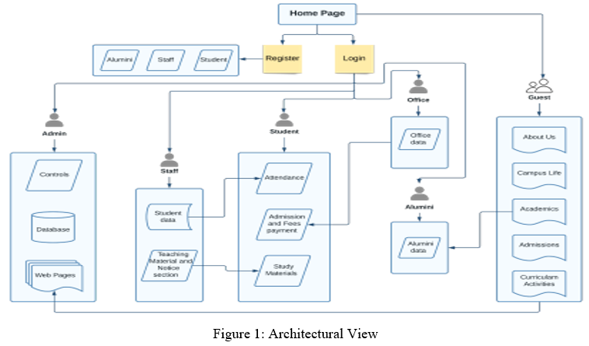
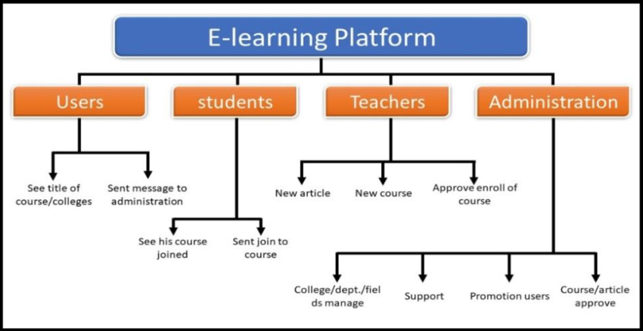
BLOCK DIAGRAM

Slide 10
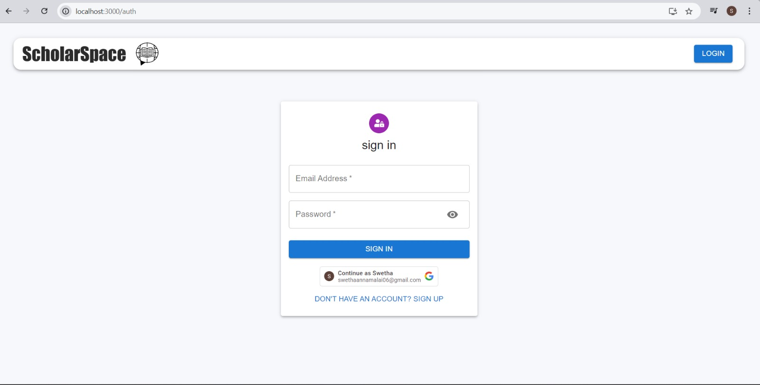

MODEL SCREENSHOT

Slide 11
CONCLUSION
Delivering instructional content is made easy, scalable, and reliable by the Online Learning Platform, which is based on the MERN stack. The platform guarantees an engaging learning experience with real-time updates, secure data management, and an adaptable design by leveraging the most recent web technologies. Multimedia materials, individualized learning paths, and interactive elements can all be seamlessly integrated because to the system's flexibility. Because of its scalability, it may be used by schools of all sizes, allowing for effective student progress management and the creation of a more dynamic and immersive learning environment.

Slide 12
THANK YOU

